Slide 1

WEVECON TELECOM ANALYSIS

Slide 2
Effect of 5G Launch by Wavecon Telecom
Presenter: Ajit Kumar Muni
Date: July 2023

Slide 3

Introduction
Wavecon, a top telecom company, has just launched new 5G services, showing its dedication to using the latest technology. But while everyone is excited about this, Wavecon still has to deal with both challenges and opportunities in the telecom world.

Slide 4

Objectives
1. Assess the impact on revenue.
2. Identify underperforming KPIs post-launch.
3. Evaluate plan performance in terms of revenue.
4. Determine if any plans should be continued or discontinued.
5. Identify discontinued plans and the reasons.

Slide 5
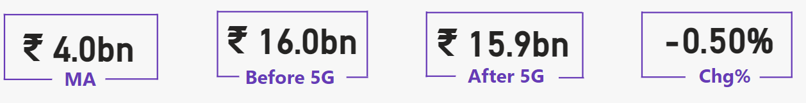
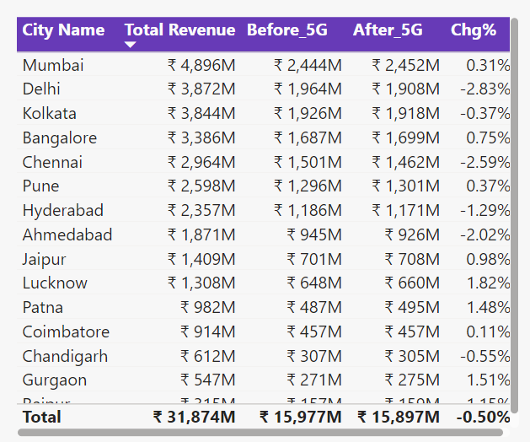
Impact on Revenue
Overall Revenue Change: Decreased by 0.5%.
Top Performing Cities: Lucknow, Gurgaon, Patna (Revenue increase of ~1.5%).
Least Performing Cities: Ahmedabad, Chennai, Delhi (Revenue decrease averaging below 2.48%).

Slide 6
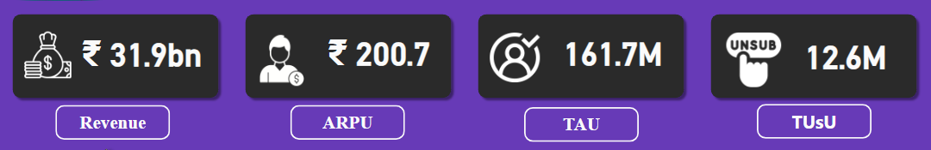
Key Performance Indicators (KPIs)
Total Revenue Generated: Rs. 31.9 billion.
ARPU (Average Revenue Per User): Rs. 200.
TAU (Total Active Users): 161.7 million.
TUSU (Total Un-Subscribed Users): 12.6 million.

Slide 7
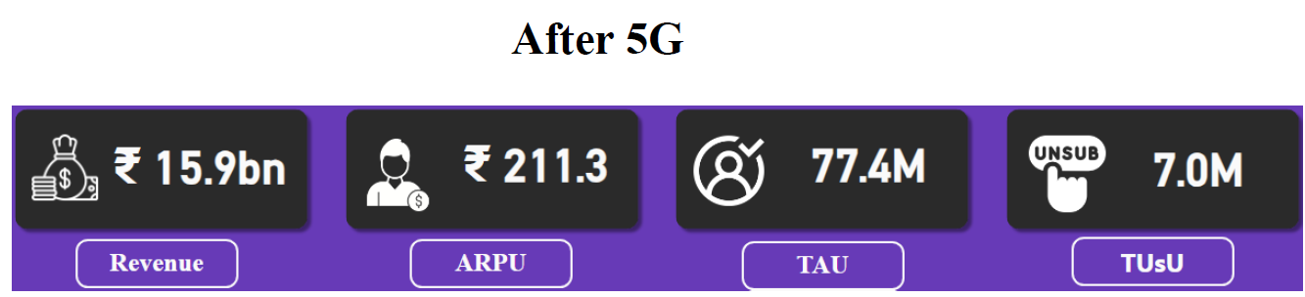
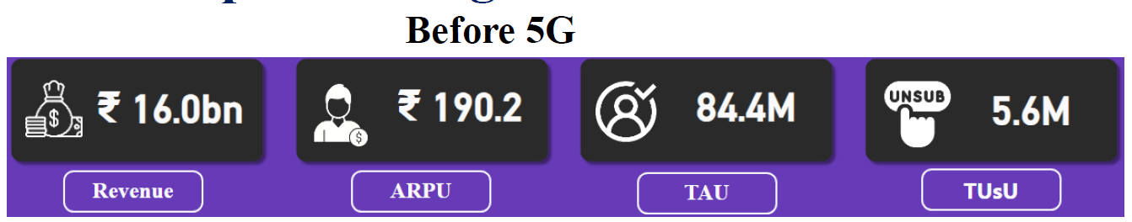
Underperforming KPIs Post-Launch
Before 5G Launch:
Revenue: Rs. 16 billion.
ARPU: Rs. 190.2.
TAU: 84.4 million.
TUSU: 5.6 million.
After 5G Launch:
Revenue: Rs. 15.9 billion.
ARPU: Rs. 211.3.
TAU: 77.4 million.
TUSU: 7 million.
Percentage Changes:
Revenue: -0.63%.
ARPU: +11.09%.
TAU: -8.29%.
TUSU: +25%.

Slide 8
Plan Performance in Revenue Post-Launch
Consistently Performing Plans: P1, P2, P3.
Declined Performance Plans: P4, P5, P6.
New Plans Introduced: P11, P12, P13.
Discontinued Plans: P8, P9, P10.

Slide 9
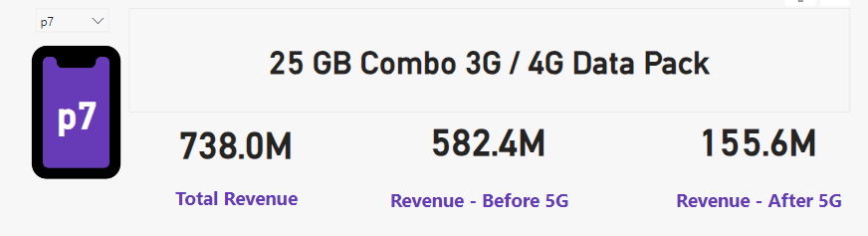
Plan Largely Affected Post-Launch
Plan 7: Significant revenue drop from 582.4M to 155.6M.

Slide 10
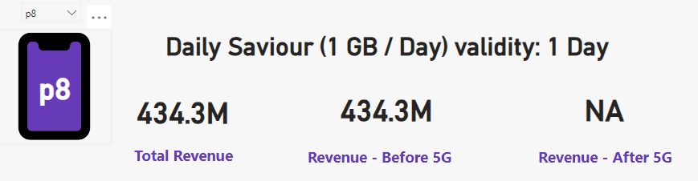
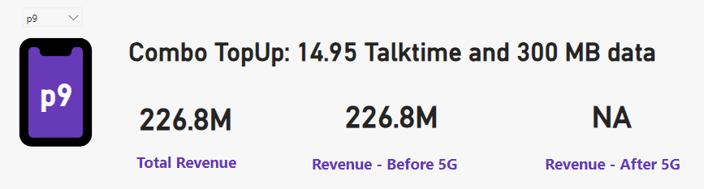

Discontinued Plans Post-Launch
Discontinued Plans: P8, P9, P10.

Slide 11

Conclusion
Summary of Key Findings:
Impact of 5G launch on revenue and KPIs.
Performance of various plans.
Recommendations for Future Actions:
Adjust marketing strategies for underperforming areas.
Reevaluate discontinued plans and new plan introductions.
Continue monitoring and optimizing KPIs.

Slide 12

Thank You
Contact Information:
Email: devraj.muni143@outlook.com
Phone: 7064649974

